Slide 1

BACKSTAGE DEMO
Kieu Nguyen

Slide 2




Agenda
Introduce
Backstage Architecture
Demo backstage template

Slide 3
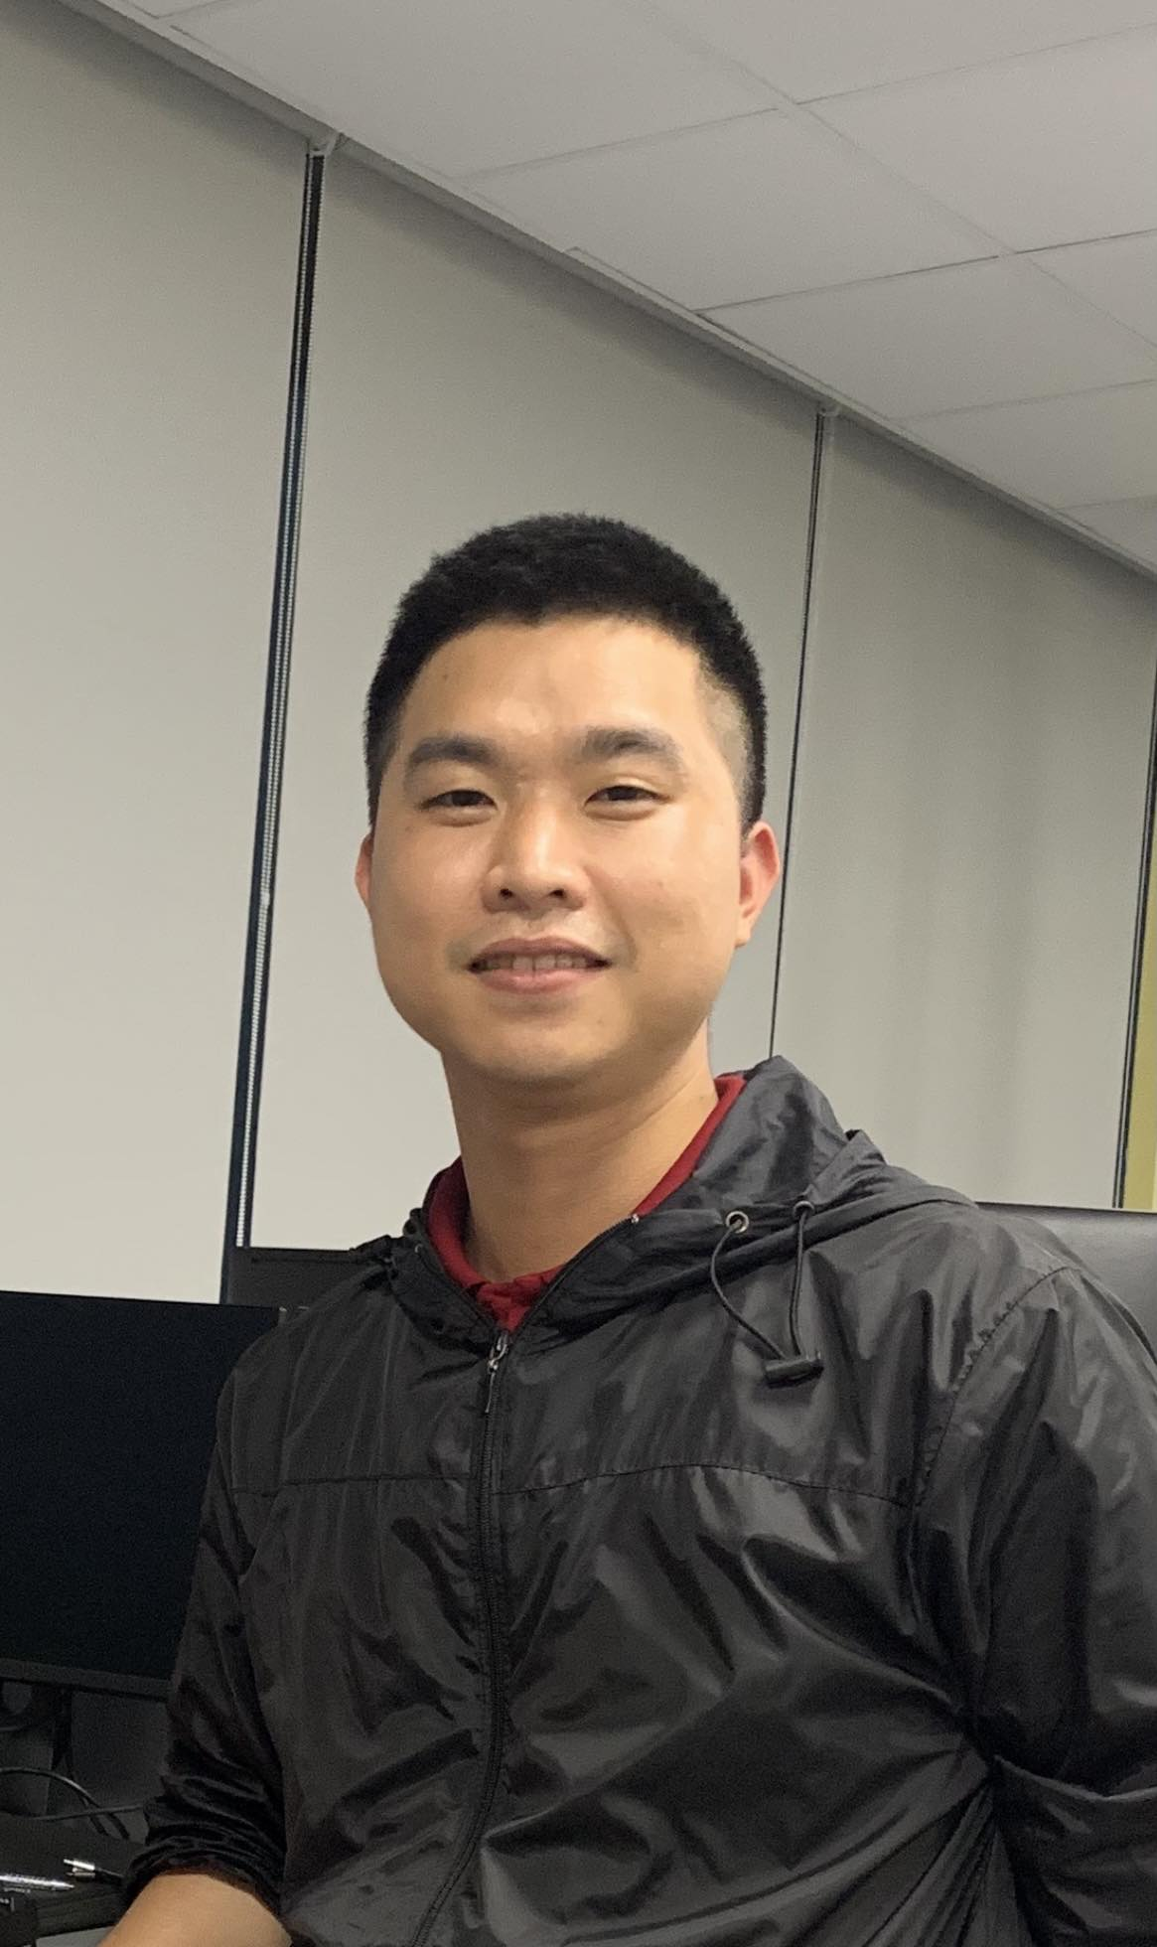
Introduction
Name: Kieu Nguyen
Birth: 29/03/1995
Personal Profile:
As a skilled DevOps engineer with 6 years of experience in IT industry, I am a highly motivated individual with a passion for designing, implementing and managing reliable, efficient, and scalable infrastructure.
I am dedicated to ongoing learning and professional development, with understanding of both software development and Cloud‑system administration, I hold myself to the highest standards of excellence in all aspects of my work. I am confident that my skills, experience, and dedication make me a valuable asset to any organization in need of a skilled and driven DevOps engineer.
Education:
Posts and Telecommunications Institute of Technology (PTIT)
Skills:
Cloud: EC2, EKS, ECS, ELB, ASG, VPC, S3, Lambda, Cloudfont, Route53, WAF, Cloudwatch, SQS, MSK, Cognito, Secrets manager, Opensearch, RDS, Mongo‑Atlas,some experiences with GCP and Azure.
Programming: Bash/Shell, Python, Lambda, FastAPI
Automate tools-CI/CD: Gitlab‑cicd, Github‑action, Jenkins, ArgoCD, Teraform, Ansible.
Containerization: Kubernetes, EKS, ECS, Docker, Dockerfile, Docker‑compose, Dockerswarm.
Monitoring and Logging: Prometheus, Grafana, Alertmanager, New‑Relic, Cloudwatch, Elasticsearch, Opsgenie‑Alerts.
System-Networking : VMware, Linux, NGINX, Databases, DHCP, NFS, DNS,TCPI/IP protocols, L2‑Switching and L3‑Routing, Firewall
Soft Skills: Self‑Study, Communication, Time Management, Teamwork, Problem‑solving, Documentation.

Slide 4
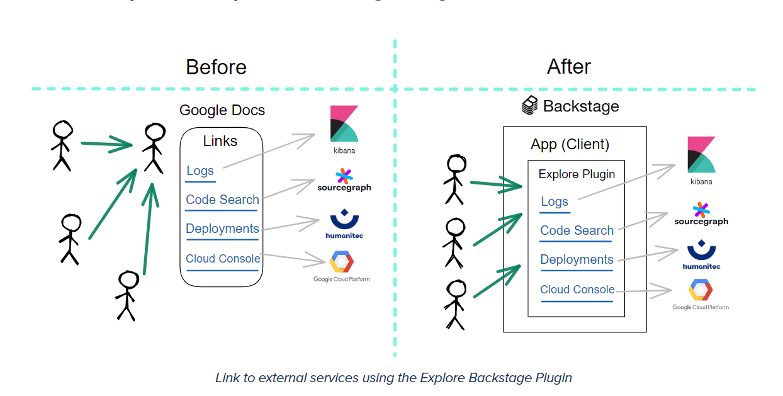
Why BACKSTAGE

Slide 5
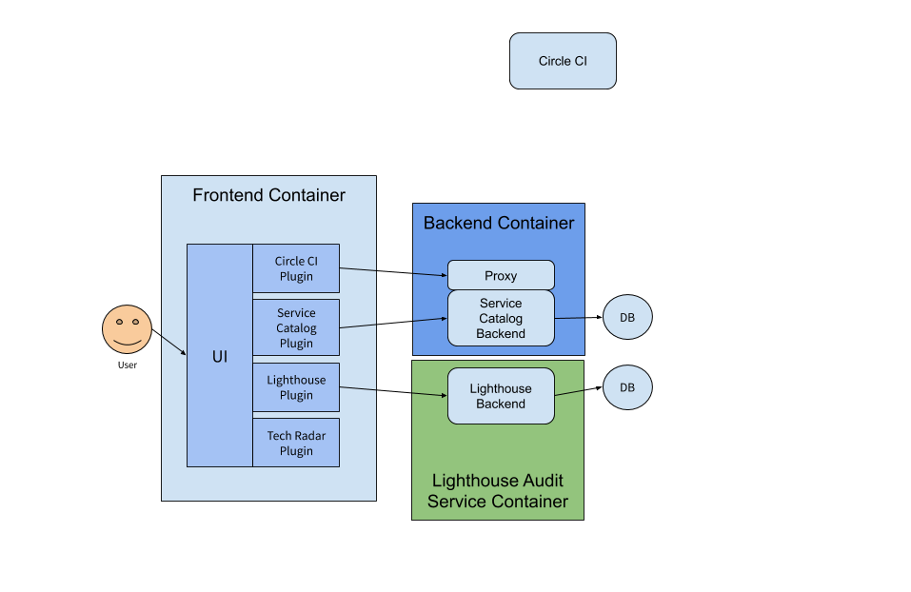
BACKSTAGE ARCHITETURE

Slide 6
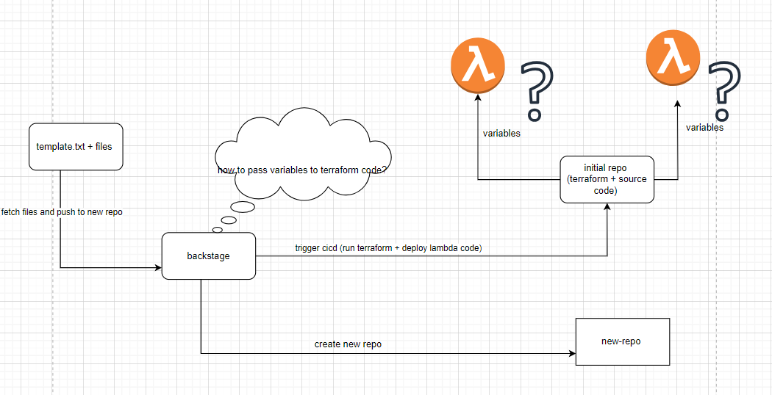
BACKSTAGE DEMO

Slide 7
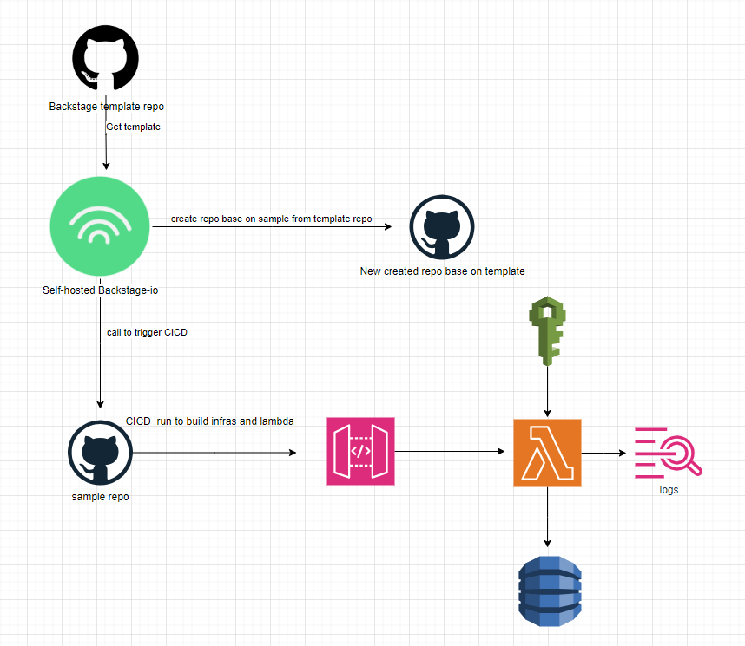
BACKSTAGE DEMO

Slide 8

Thank you
Kieu Nguyen
Email address: kieunguyen.ql@gmail.com

